Slide 1
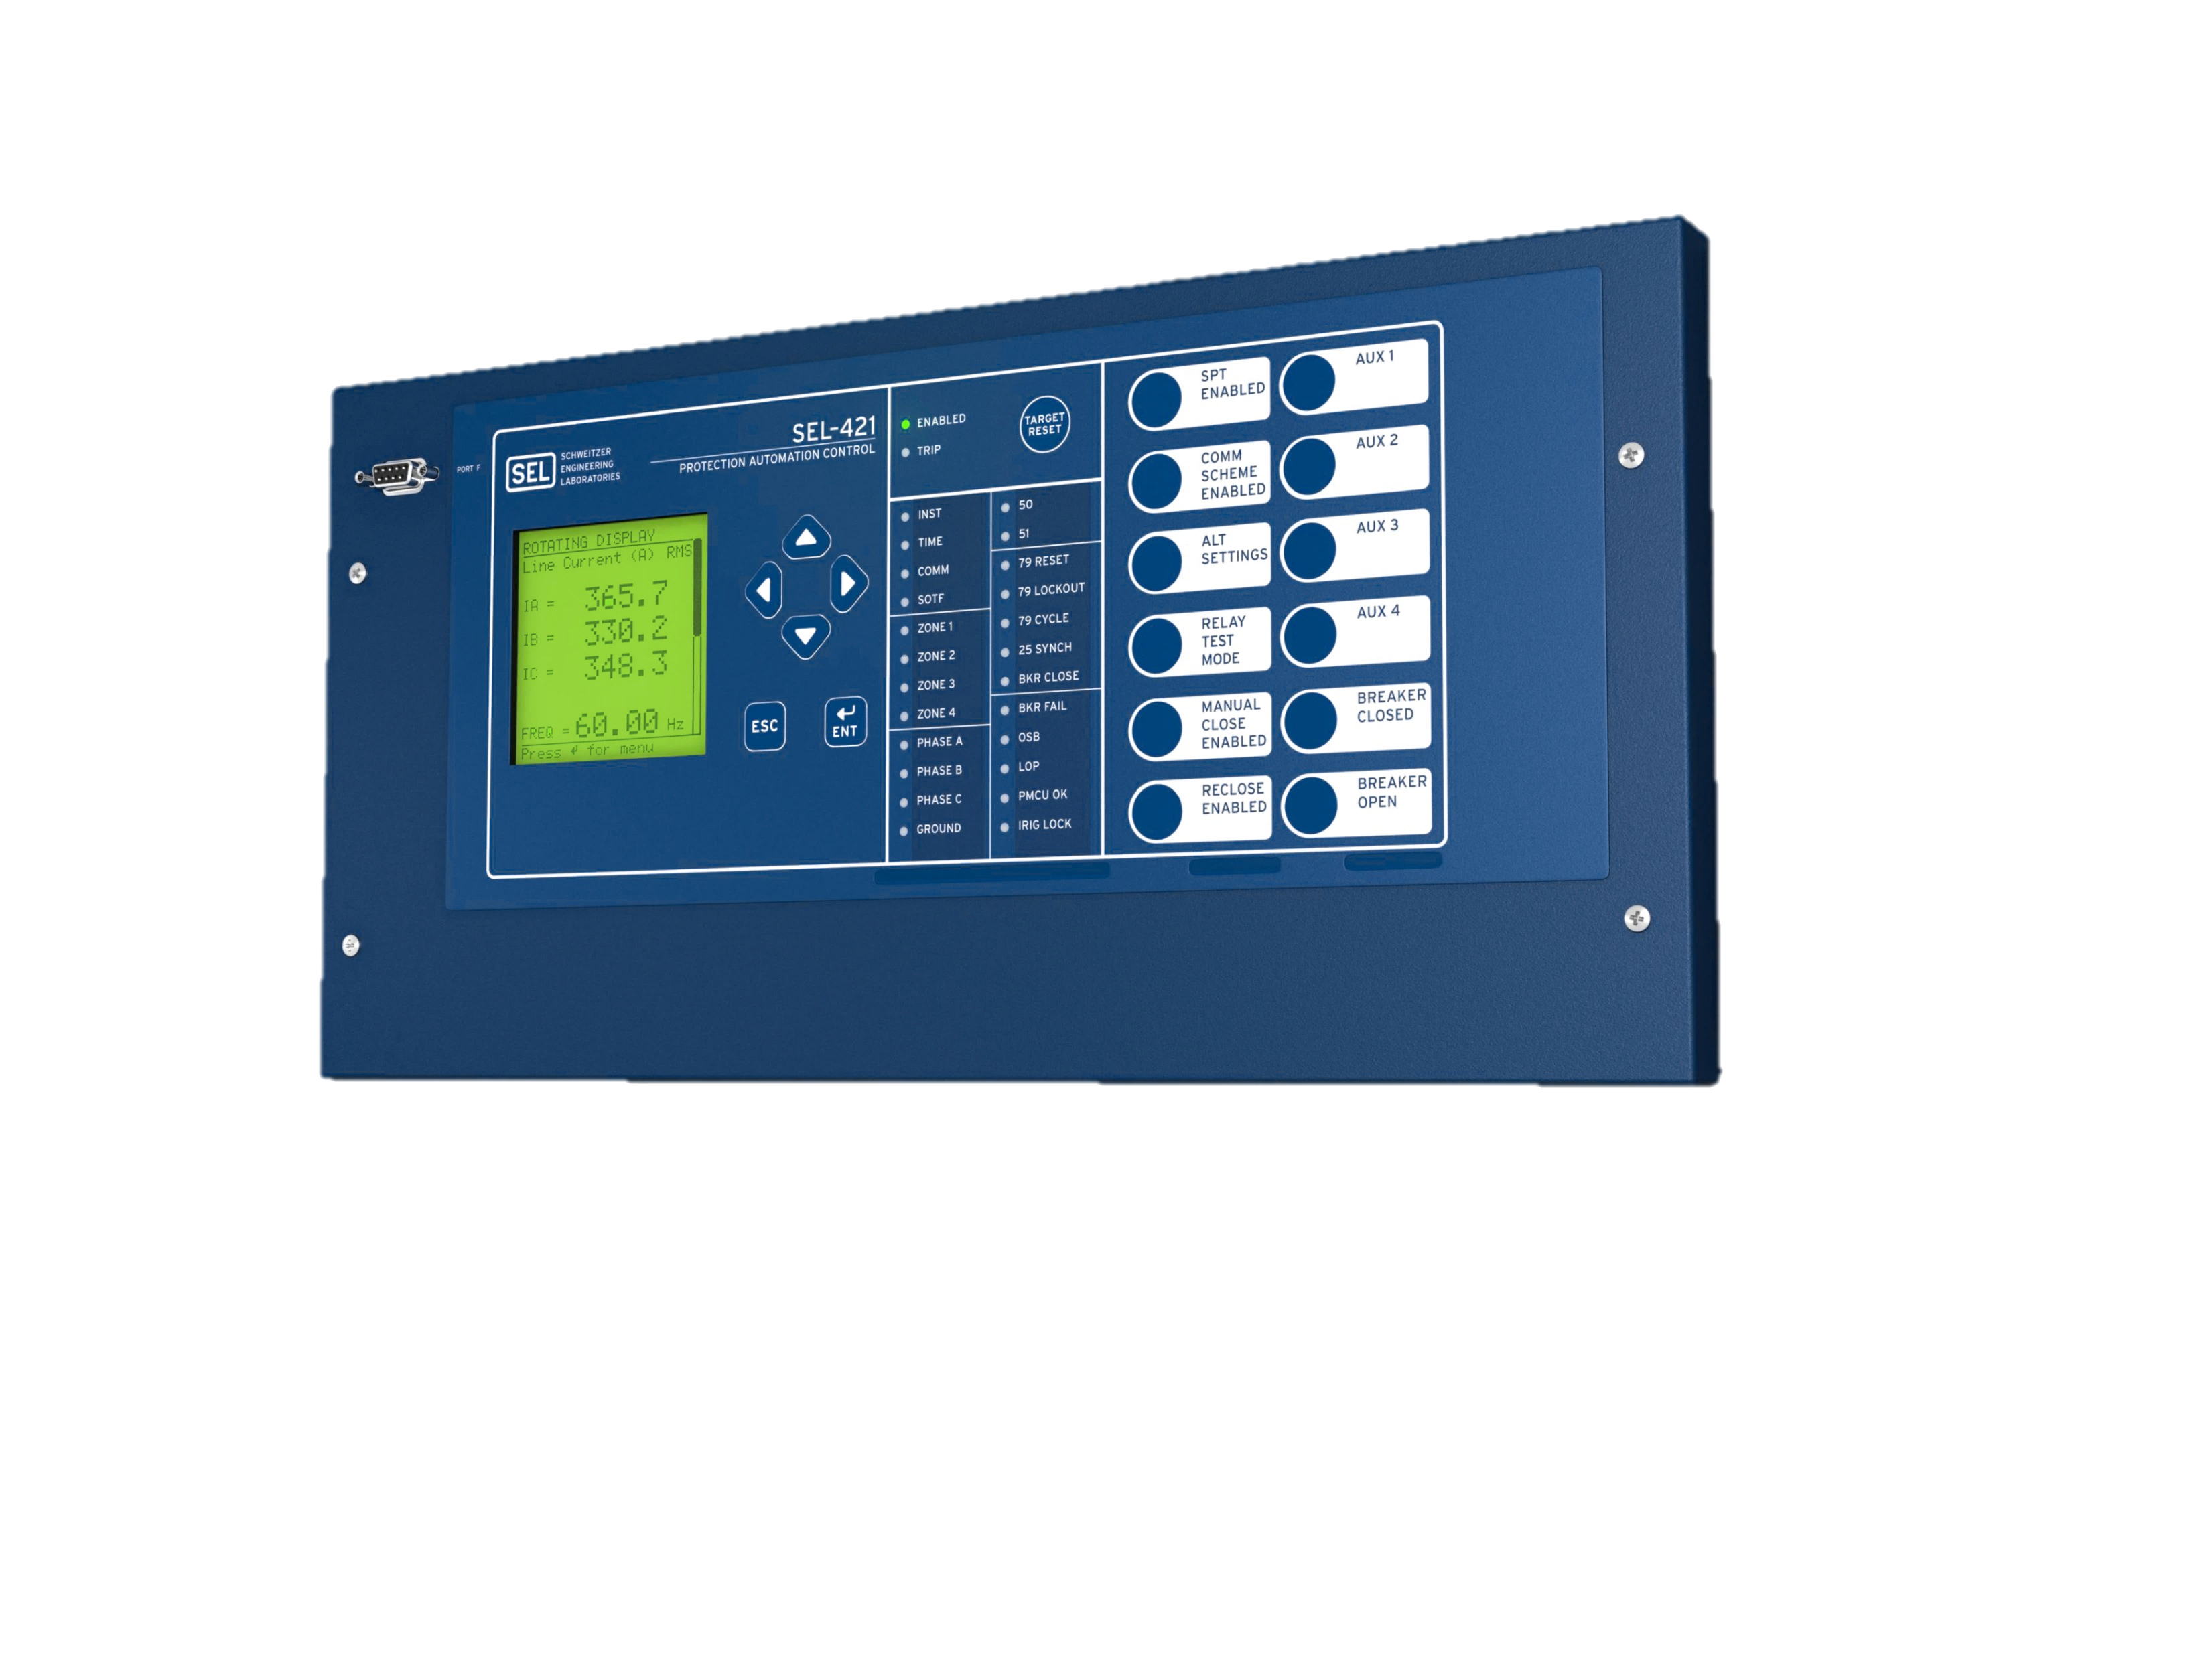

World Class SV Protection Relays
IEC 61850 Process Bus and IEC 61850 Station Bus
Two options
  Publisher (IMU) - SEL-401
  Subscriber Relay - SEL-421
Process bus monitoring
Full SEL protection functionality
Capacity for up to seven SV streams
Familiar settings
Notes:
This slide discusses the SV line distance protection relay, the SEL-421-7.
As with the SEL-401, the SEL-421-7 publisher version can send (i.e., publish) up to seven SV streams. Similarly, the SEL-421-7 subscriber version can receive (i.e., subscribe to) up to seven streams.
The SEL-421-7 is able to evaluate traffic status and statistics, which can be accessed with a command. Both versions of the SEL-421-7 have the same level of protection and functionality as the SEL‐421‐5.
The settings are also very similar to the SEL-421-5, with the exception of modifications on the SEL‐421-7 to support SV functionality. This means that the learning curve for those familiar with SEL-421 Relays should be minimal.

Slide 2
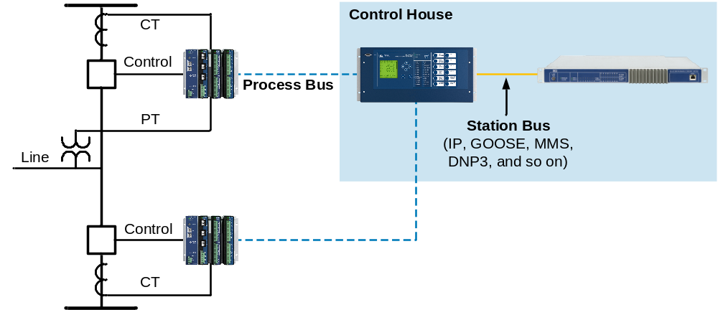
Robust Time Domain Link (TiDL) Relays
IEC 61158 Process Bus and IEC 61850 Station Bus
IEC 61158
IEC 61850
Direct connect Process Bus
  Publisher (MU) - SEL-Axion
  Subscriber Relay - SEL-421, 451, 487B, 487E, etc.

Slide 3
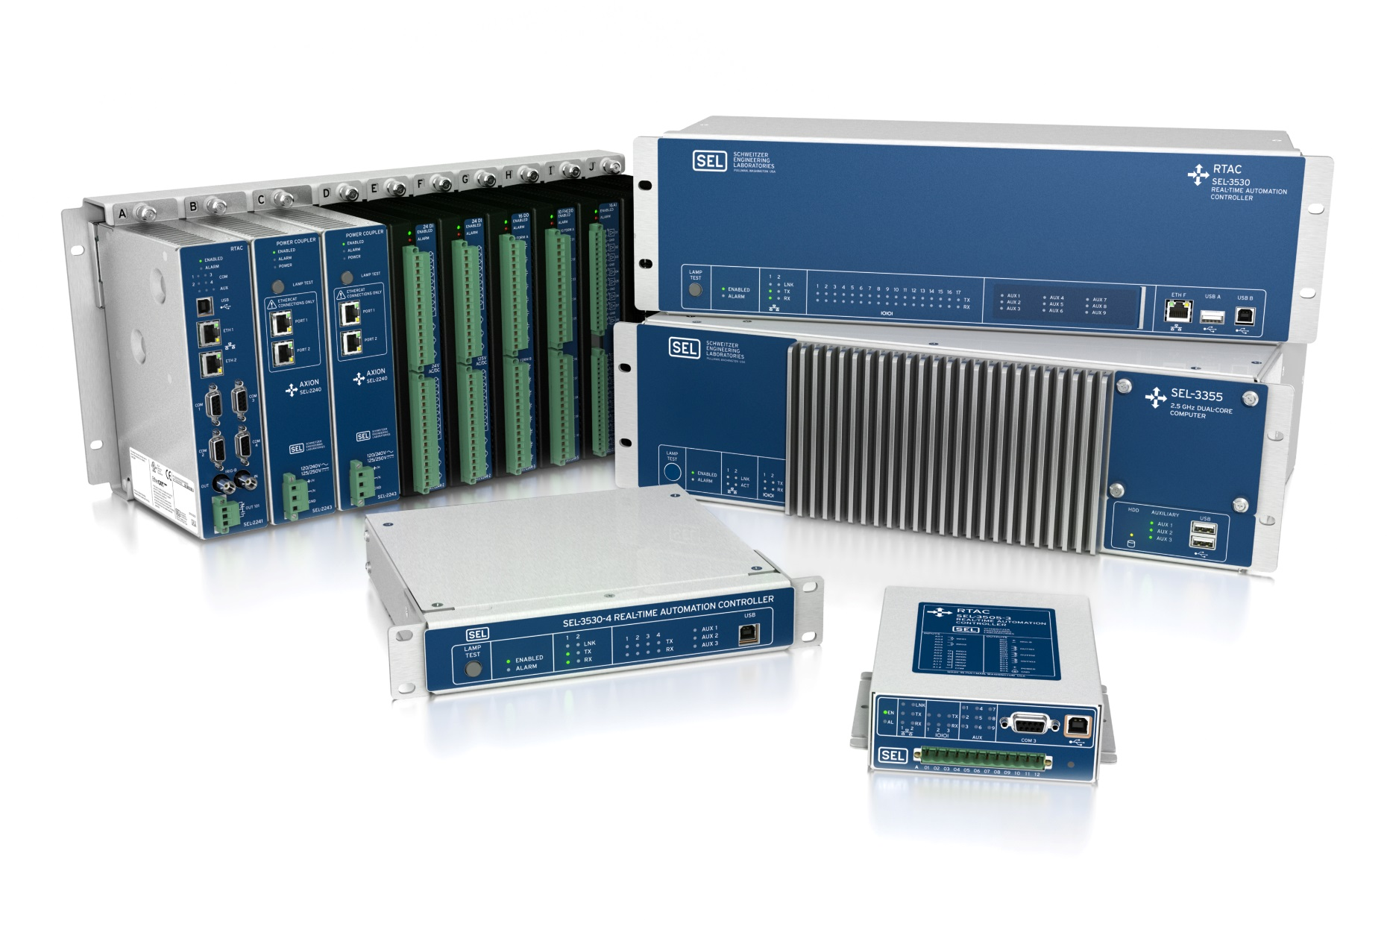

Best-in-Class IEC 61850 MMS Client and Server Gateways and Controllers
Deterministic processing with
rates as fast as 1 ms
Power management
and load shedding
Substation HMI
Built-in security with exe-GUARD® technology
Legacy protocols to IEC 61850 gateway

Slide 4
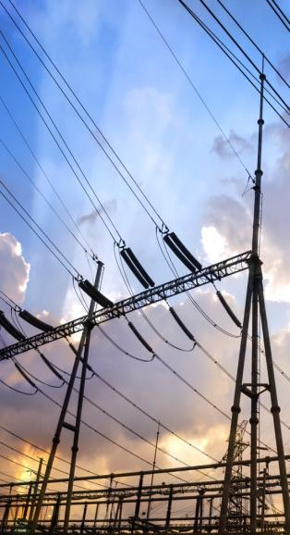

Implement IEC 61850 Digital
Secondary Systems Your Way
Use SEL’s interoperable IEC 61850-9-2 process bus with protection in merging units
Apply SEL TiDL™ IEC 61158 process bus with zero network engineering for cybersecure engineered simplicity
Put SEL relays in the yard for the fastest protection speeds
Notes:
This “What It GIVES” statement is 76 words.

Slide 5
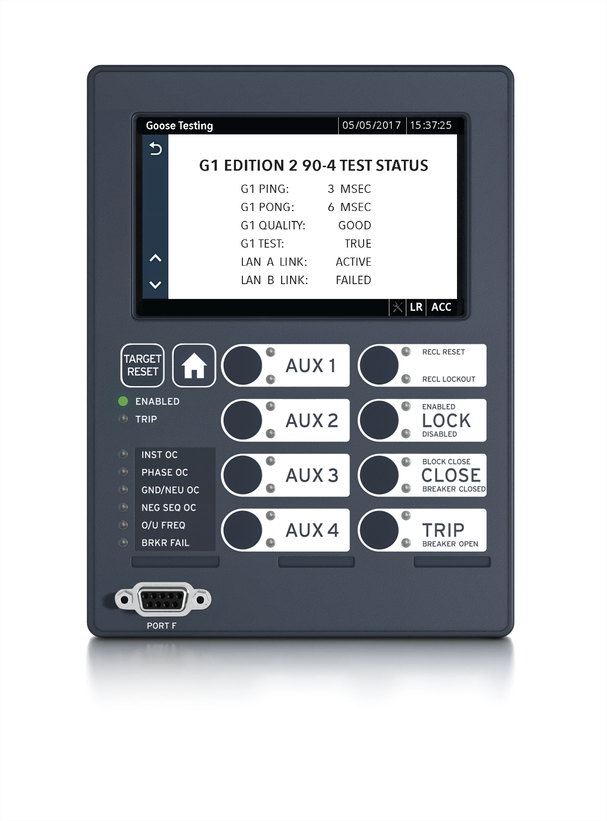
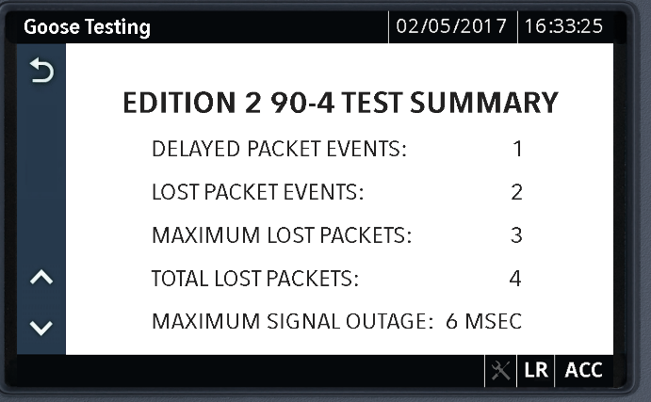
Essential IED GOOSE Event Reports
Subscriber Records Delayed and
Lost Packets to Satisfy IEC / TR 61850-90-4
Network Engineering Guidelines

