Slide 1
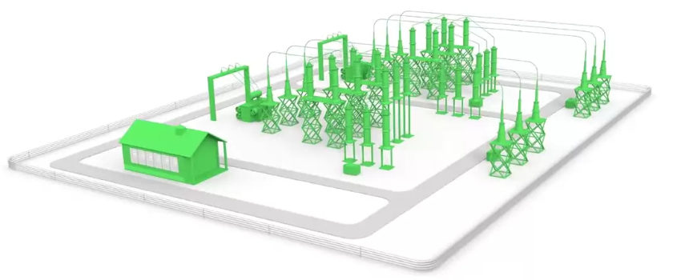
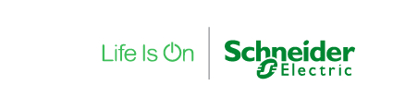
Bringing an IED fully compliant with latest standards…
Condition Monitoring
and Asset performance management:
ISO 55000
Stand alone Merging unit (SAMU)
Non conventional Instrument transformer (NCIT)
IEC 61850-9-2, IEC 61869-13
IEC 61850-8-1 Station bus:
Protection and Control System
Time synchronization IEEE1588
End to end Cybersecurity
IEC62443, IEC62351
NERC-CIP
IEC 61869 Process bus
Sample values IEC 61850-9-2
CB control IEC 61850-8-1 Goose
Time synchro IEEE 1588
Breaker IEDs
Smart Terminal blocks IEC 61850
Evolving requirements
Non mature standards
Notes:
IMPLICATIONS of Market and Technological TRENDS are new regulation and standards

Slide 2
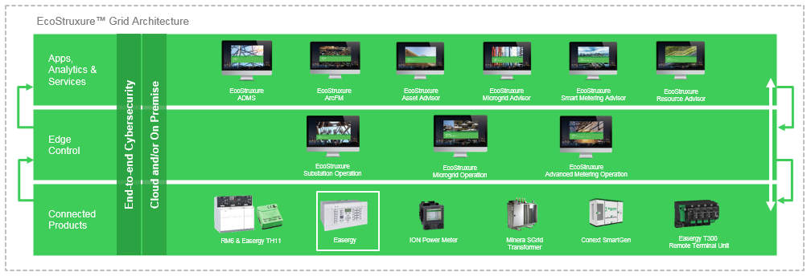
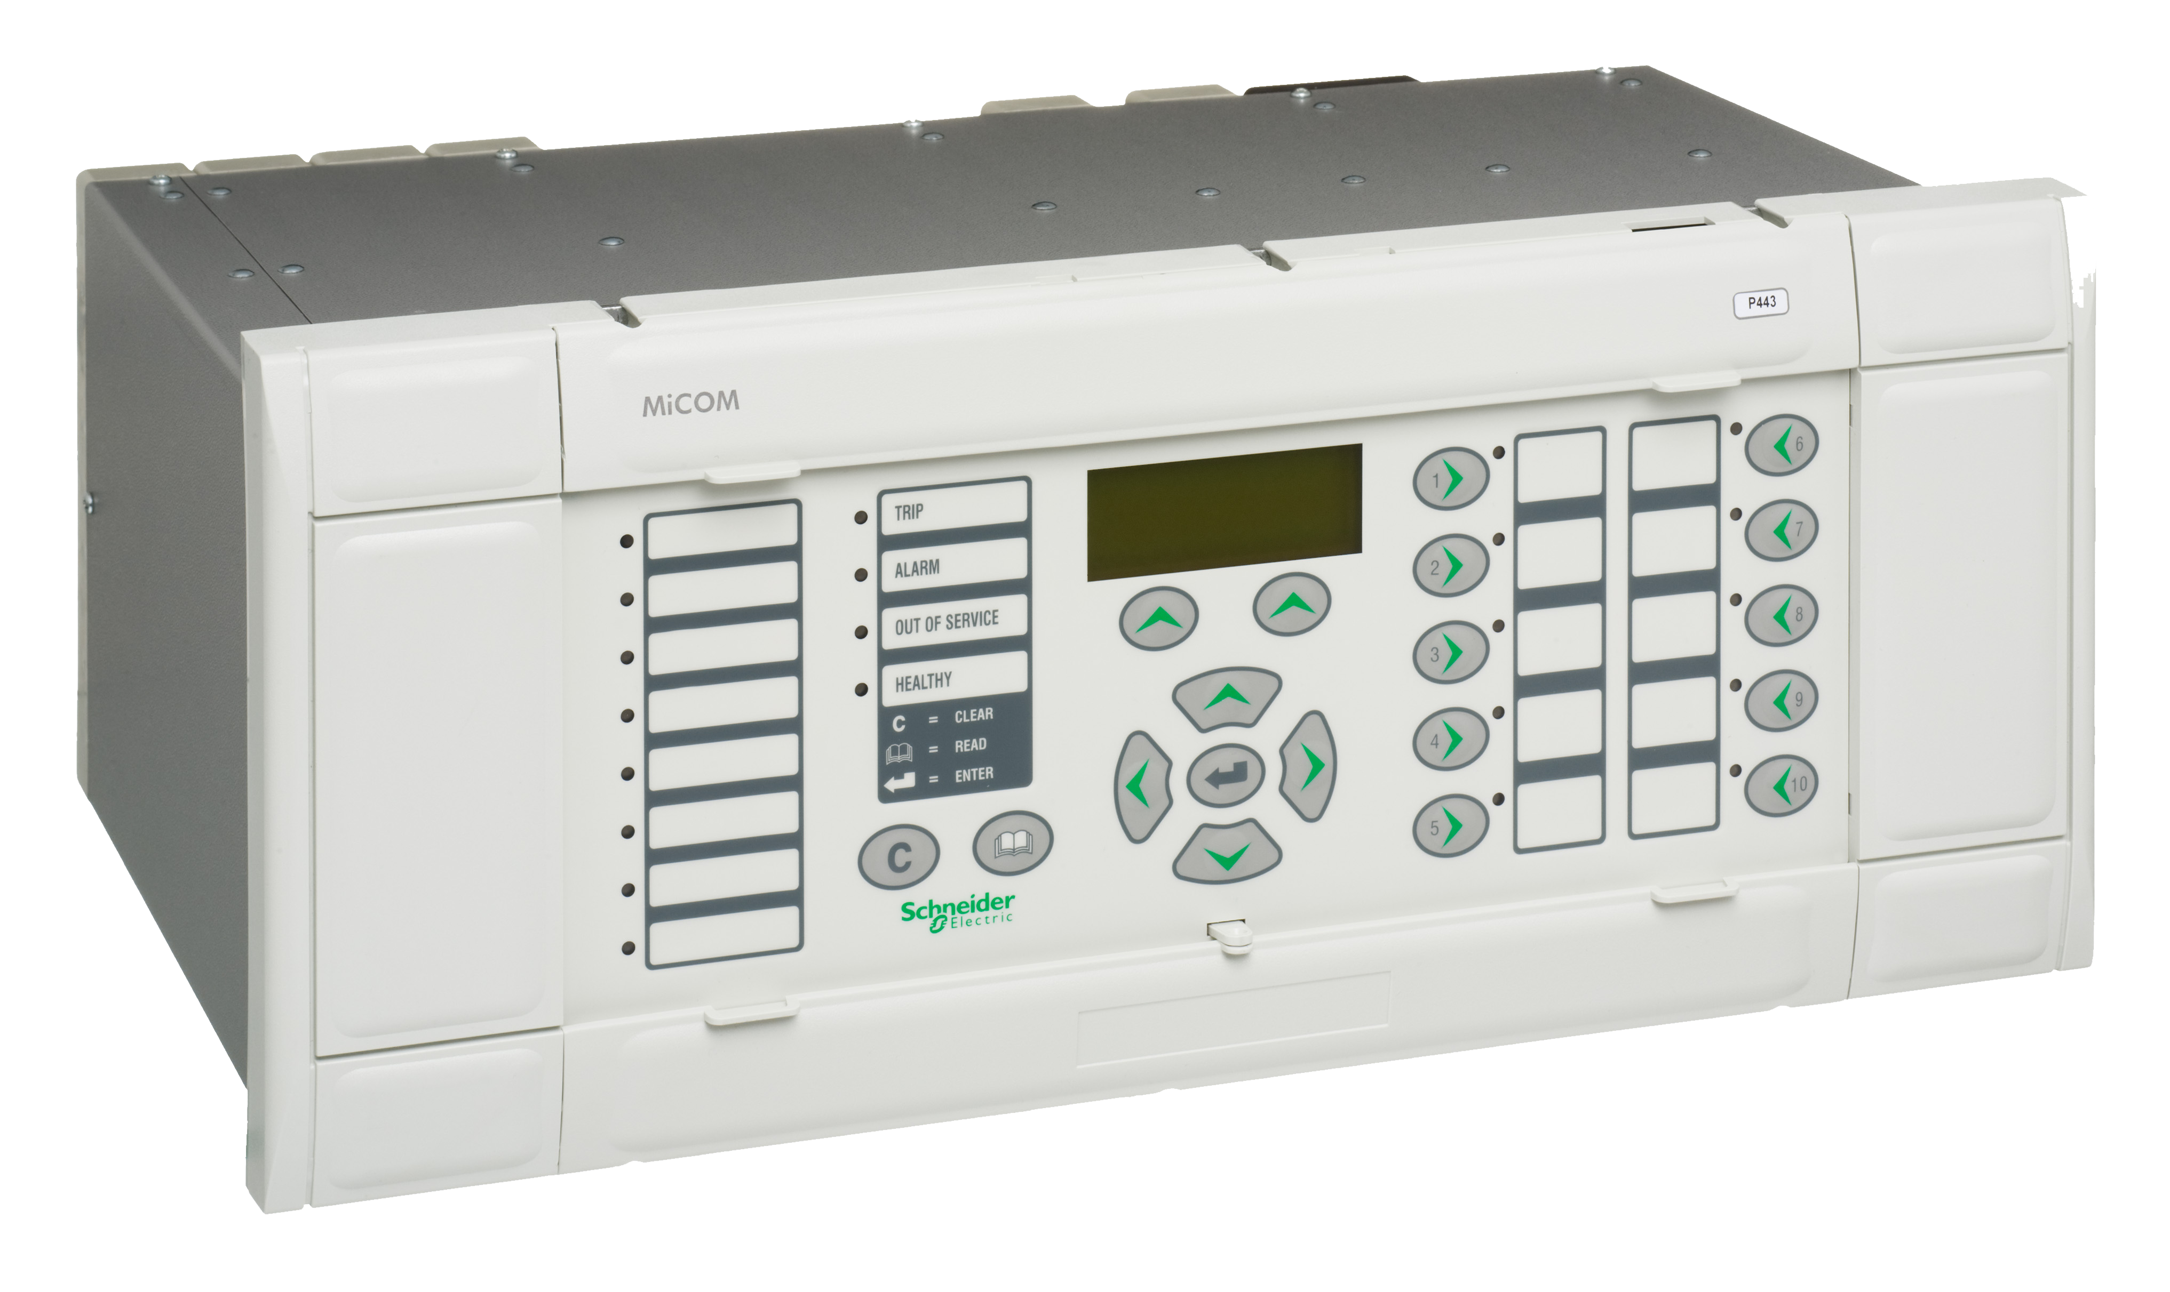
Digital substations using
IEC 61869 standard,
fully supported by EcostruxureTM Grid, the IoT-enabled architecture for electrical utilities, to deliver significant benefits:
EcoStruxureTM Grid architecture
CAPEX reduction
People safety
Full interoperability
Maintainability
Easergy MiCOM protection relays
Reliability & availability

Slide 3


Discover more about EcostruxureTM Grid
Schneider Electric booth, Floor 1 #117
Join us to get a demo of our innovative solutions:
    Digital substation and cyber security
    Advanced management and geographic
    Information systems
    Microgrids
    Asset management
Discover more about EcoStruxure Grid
on the Schneider Electric booth, Floor 1 #117

