Slide 1

Growing Digital Energy Solutions in Utilities
Powered by EcoStruxure™ Substation Operation, Feeder Automation, Intelligent Switchgear & Smart Relays
May 2018

Slide 2

Notes:
Energy World challenges
Decabornization : regulation address climate change challenge
Decentralization : Profileration of DER
Digitization : Proliferation of connected IoT devices + need to have IT & OT integrated
More electric : customers more empowered & demanding
Increasing cyber-attacks threats on grid systems & infrastructures

Slide 3
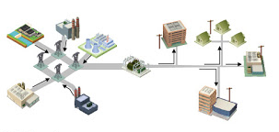
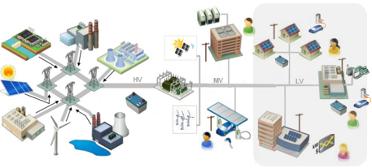
Utilities are gradually transitioning to a new model. The pace is dictated by government and energy regulators
From simple value chain and market model…
… to complex model with extended value chain
Prosumers
Communities
Privatization
Retail competition
Vertically integrated monopoly:
Generation – Transmission - Distribution
Unbundling
Energy as a Service
Wholesale competition
Transactive energy,
meshgrid
New players

Slide 4
The future energy system is also technically more complex, requiring new design & operating practices, new technology and skills
From G. Westinghouse and N. Tesla legacy…
… to a complex system with new rules
Lower system inertia
New loads (EV…)
Inertia based grid stability
(large spinning generators)
Inverter-based
generator connection
Digital technology
Stability issues
More flexibility needed:
Flexible generation, storage, demand response

Slide 5
Digital transformation impact on utilities
Difficulties & Strategic options to manage IT/OT transformation
Most distribution utilities are facing difficulties to go digital
Utities may not have the ability or critical size to hire the necessary talents
Many utilities refer to communication infrastructure as the starting point of digital; It goes far beyond that
Implementation of digital strategies requires breaking down organization siloes within the companies, often touching business process reengineering (getting IT and OT staff to work together)
Digital technologies do not necessarily fit in current investment regulation
Hiring a consultant or outsourcing to vendors is often considered

Slide 6
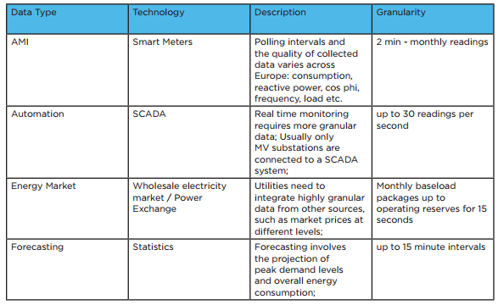

What kind of data are we talking about ?
Metering, grid, market, forecast…
Grid status

Slide 7
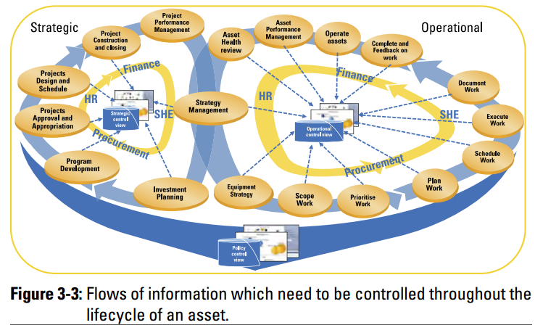
Strategic and operational asset management perspectives
Most utilities have partial view of and embryonic implementation of asset management.
They tend to be unaware of the potential added value of the technology for CAPEX/OPEX optimization…

Slide 8
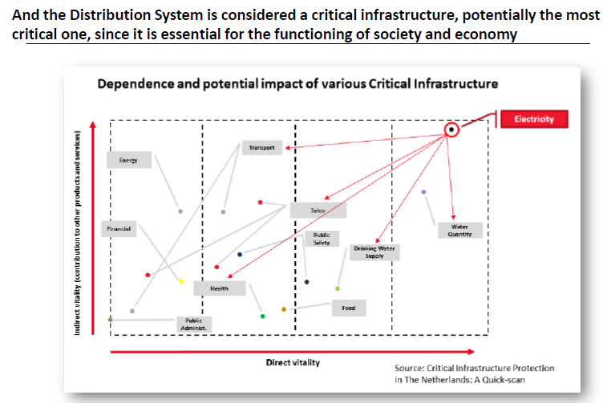
Electrical networks are among most critical infrastructures
Cybersecurity is a major concern
Recent attacks reveal a growing threat
Utilities are unprepared : Vulnerability is real on infrastructure
Which standards? : Country-specific, compliance to laws and regulations, international standards?
Where to start? Which support is best suited ?

Slide 9

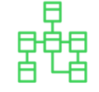

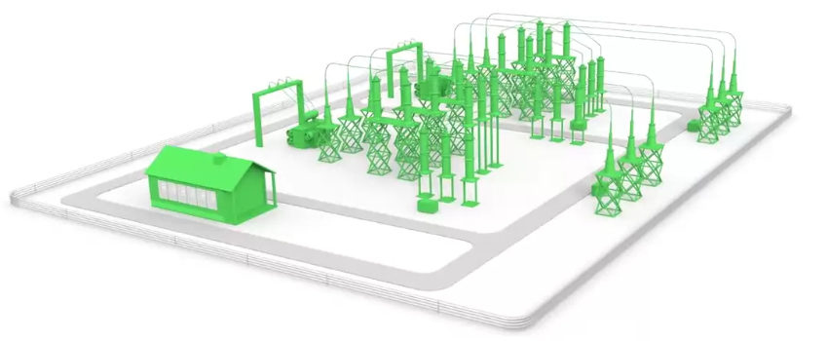

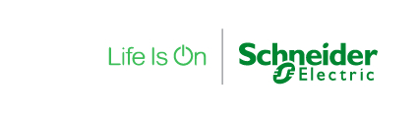
More Regulations and Standards impacting HV and MV…
Condition Monitoring
and Asset performance management:
ISO 55000
Stand alone Merging unit (SAMU)
Non conventional Instrument transformer (NCIT)
IEC 61850-9-2, IEC 61869-13
End to end Cybersecurity
IEC62443, IEC62351
NERC-CIP
IEC 61869-2 Process bus
Sample values IEC 61850-9-2
CB control IEC 61850-8-1 Goose
Time synchro IEEE 1588
IEC 61850-8-1 Station bus:
Protection and Control System
Time synchronization IEEE1588
Breaker IEDs
Smart Terminal blocks IEC 61850
Non mature standards
Notes:
IMPLICATIONS of Market and Technological TRENDS are new regulation and standards

Slide 10
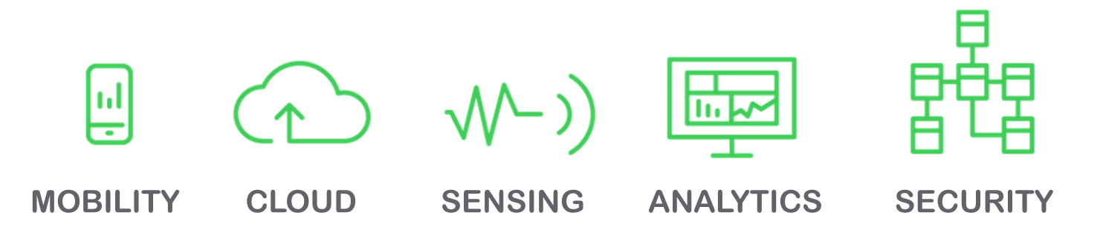
Digital Distribution System 4.0 is now powered by
IoT and Industry 4.0 enable Digital Transformation to do more with data in the aim of
  Improving operational efficiency
  Transitioning to predictive maintenance
  Optimizing asset management decision-making by providing pertinent information from data analysis
Notes:
Technological TRENDS :
Mobility
➔ Smart Aps products & system
Security & Availability : Resilience
Strengthened Cyber Security
Cloud, Sensing and Analytics
➔ Condition Base Monitoring, Asset Performance Management
Management tool technical evolution :
1990 – Information exchanges => Monitoring and data management solutions
2000 -- Control => real time control solutions
2005 – Processes => bi directional control and predictive analysis solutions
2010 – Enterprise => Control data exchange solutions – IT:OT data interaction

Slide 11
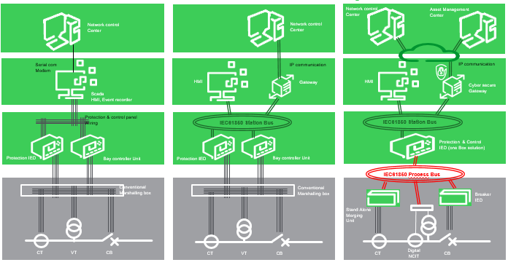
Inflexion Point in this Journey…
Conventional wired substation
Digital control Panel
Digital Substation 4.0
Enterprise level
Edge
control
Connected Product
MV switchboard
Connected products
Equipment & sensors
Powered 1st Gen Digital Relays
Powered by IEC61850
Powered by IEC61850 & Sensors
2000
2020
Notes:
2 main evolutions : Station bus in 2015s and Process bus for a complete digital evolution from Connected products & equipents to Enterprise level
We foresee a next coming evolution to Virtualization in coming 10 years
Value proposition
Counter ABB, Siemens, GE
Distribute Voltage measurement across cubicle for Directional, Synchro check and Power measurement application.
Refurbishment business by removing existing wires to fiber for safety reason
Process bus can speedup refurbishment
Current sharing for HV/MV Transformer Diff protection is a targeted application

Slide 12

Schneider-Electric is part this digital journey…
Cybersecurity
+ 30 projects
EUR E/N
400+
EUR W/S
400+
NAM
50+
CBM/APM
3 projects
M. EAST
200+
APAC
150+
IND
150+
SAM
250+
Process Bus
3 projects
AFR
200+
Digitized I/O
+5 projects
Notes:
PACiS is a well-known solution by customers, launched in the Substation Automation market since 2002, with a global footprint. Today, we can claim that more than 1800 systems have been delivered worldwide, making the solution a success.
Digitized solutions :
Cybersecurity : Sold in O&G, Utility and Defense ( Chevron, BP, DTN ( French defense), Total…). More than 21M€ projects done including more than 4M€ cybersecurity. We are now quoting projects in Asia and SAM
CBM/APM : Sold in O&G ( Umm Lulu Abu Dhabi )
Processbus : Sold in Utility market ( Helen Finland 2016, Powerlink Australia 2017). Working now on a project with PEA Thailand
Digitized I/O : Sold in Utility and O&G ( Enedis, EDCL, Sonatrach… )

Slide 13
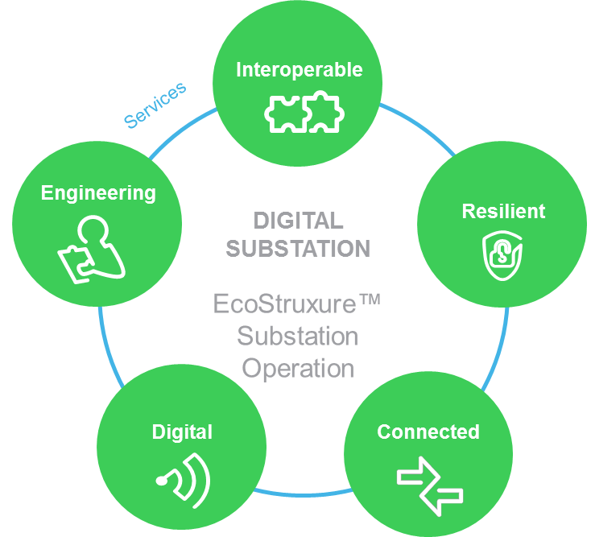




Digital Energy System Pillars
Powered by EcoStruxure™ Substation Operation, Relays, Controllers & Intelligent Swtichgear
IEC61850 and companion standards
Communication standard protocol
Architectures principle
Streamlined Engineering
Cybersecurity standards
System Engineering over lifecycle
System & IEDs configuration
System & IEDs validation & test
System monitoring
System upgrade
Cyber Security
Redundancy at all critical levels
Protection & Automation schemes
Medium Voltage LPCT/LPVT
Condition monitoring smart sensors
Digitized Information
Software-defined technologies
Digital relays
Control Centre interface
Wide Area Automation
Asset Performance Management
Workforce mobility with Smart Aps
Notes:
Digital answer of SPC & ACS – Key drivers defined in 5 pillars :
Multi-Dimensional interoperability
Leveraging IEC61850 & companions for communication, cyber-security, architectures, engineering
Resilience
Leveraging cyber-security, availability, redundancy, predictiveness and domain-specific schemes
Digital Substation is connected into customer eco-systems
Integrating in control centers, asset management systems, mobile workforce management
Information Digitization
Leveraging process bus integration, low power instrument transformers, condition monitoring smart sensors
Life-cycle Engineering
Providing methods and tools over lifecycle for design, specification, configuration, testing, commissioning and operation phases.
→ Fit for purpose solution

Slide 14







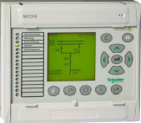

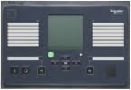

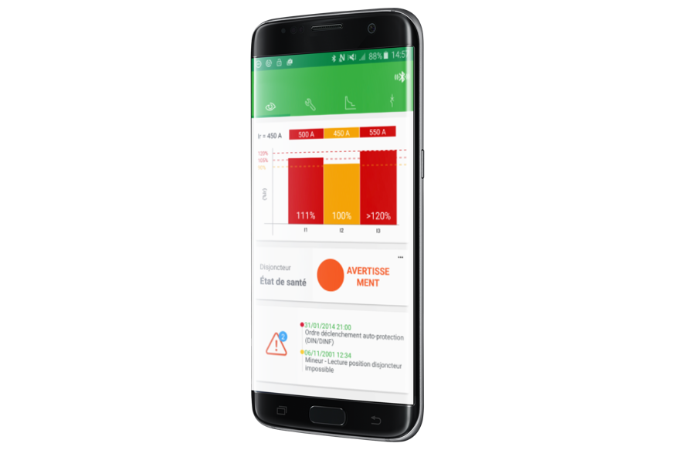





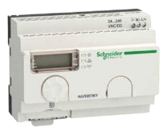
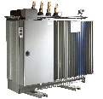
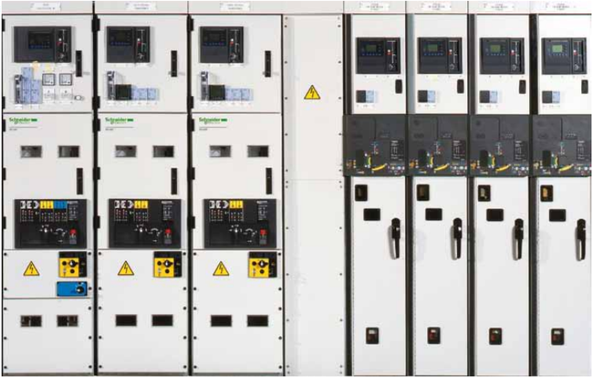
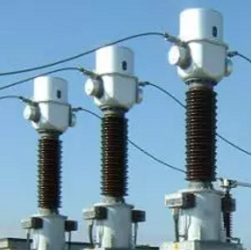
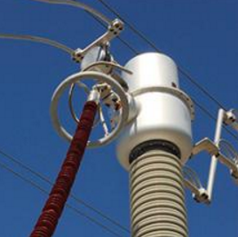
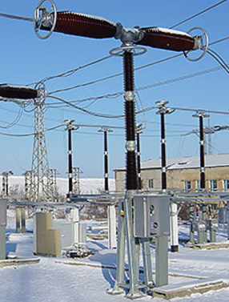
Schneider-Electric Digital 4.0 Architecture
Powered by EcoStruxure™ Substation Operation, Relays, Controllers & Intelligent Swtichgear
EcoStruxure™
Grid Engineering Advisor
Asset Management
software
EMS
Corporate RBAC
and PKI
Customer
Application Software
EcoStruxure™
Asset Advisor
Schneider
Service experts
Cloud
Analytics
and apps
Enterprise Intranet
EcoStruxure™
Substation Operation (Pacis)
Pacis GW
Edge
Control
Station Bus
HV Switchyard
SMD
Connected products
MV Switch board
Protection
Relay
Bay
Controller
Protection
Relay
Product App, Thermal App
Switchboard App with Augmented reality
IEC61869 Process Bus
Condition monitoring:
Merging unit
Connected products
Equipment and sensors
Minera SGrid
Transformer
MCSET / PIX
Conventionnal CT, VT
NCIT
LPCT
Page 14
LPVT
TH110
CB Digital
Arc flash
Notes:
Major Requirements: SAMU delivers IEC61869 -13 (Arteche) + Breaker IED (Saitel DR or 61850 SMTB converter)
Typical Application : Switchyard solution. Preferred for AIS refurbishment of the Substation Automation part only (Primary equipment stay in place)
MiCOM P40 and C264, then Easergy P5 with Sample Value Subscriber and Publisher and Easergy P7

Slide 15

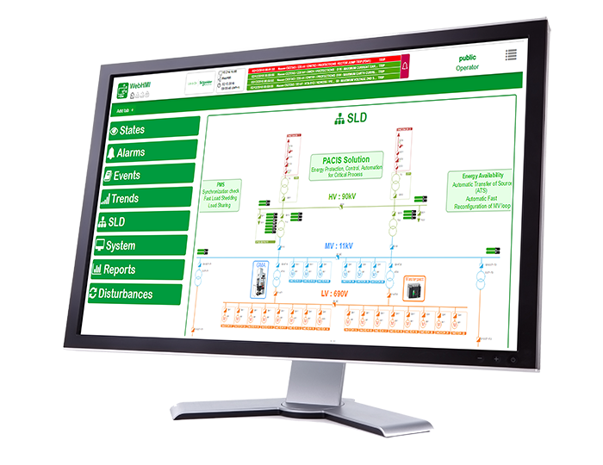
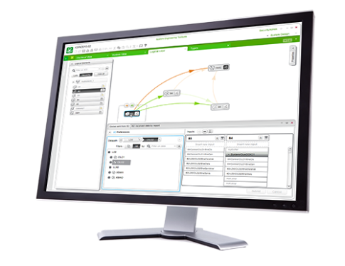


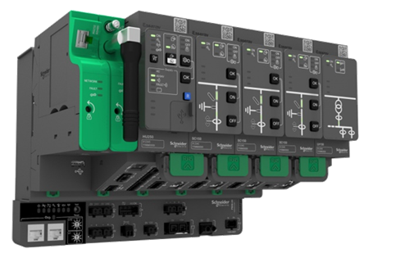

What Outcomes do we Sell to Our Customers?
Value for Customers
EcoStruxure™
Grid Engineering Advisor
EcoStruxure™
Asset Advisor
Services
Apps, Analytics & Services
< 20%
< 40%
Secure
Reduce deployment costs
Reduce maintenance costs
Extend cybersecurity
Substation Front End
Substation SCADA
EcoStruxure™ Grid Engineering Advisor
Edge Control
CAPEX & OPEX optimization
Eases design, engineering & evolutions
Participates actively to predictive maintenance
Improves operational security & process reliability
Integrates fully into corporate process and systems
Protection relays
Controllers
Controller
Smart sensors
Connected Products
Notes:
Reduce deployment costs : Thanks to IEC61850 streamlined engineering process and cable reduction, footprint reduction and system installation easiness enabled by digital technology to interface electrical process
Reduce maintenance costs : Thanks to condition-based monitoring and capability to expose data to dedicated asset performance management application
Extend cybersecurity : In 2018 and onwards, every new substation network should be secured. We have set up a unique cybersecurity offer made of technical bricks and complete services to accompany each step of the project

Slide 16


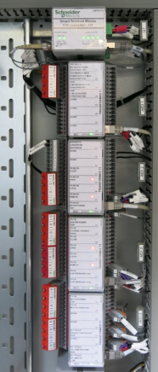
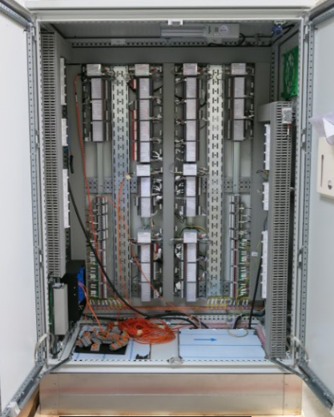
EDCL Utility - Rwanda
Contractor - Japan
  Request
Offer
Digital Substation Automation, WebHMI,
Control Panels, Marshalling Kiosks, Optical Interface with STB, I/Os redundancy, IEC61850 Ethernet Ring architecture
Telecom : PABX (Alcatel), Multiplexer SDH ( ECI)
Services
Network and Protection study
Global design and realization, with EcoStruxure Grid Advisor, FAT, SAT, Trainings
Contract
1M€
Customer Benefits
Safety and energy availability in hot environment : - 50% outages
Simplicity for current staff, fast learning for maintenance operators
Unique supplier for substation and telecoms delivery
Easily installed, connected and tested :
- 40% faster than conventional
Global services & training package
Upgrade 4 Substation 110kV/ 15 kV
Scope : Network study,
Automation and Control system, kiosks
Key Challenges
Delivery < 12 Months
Minimise on site wiring
Global package
Marshaling Kiosk
Optical Fiber
Schneider Electric Benefits
Strong Prescription via Cooperation with Schneider Japan
TAKAOKA and Yachiyo confidence from previous projects
Attractiveness of STB solution vs conventional solution originally requested
Smart Terminal Blocks DI/DO
Notes:
Use of Smart Terminal blocks in marshaling kiosks to upgrade substation utility substation of EDCL ( DSO/TSO). The replacement of copper wire have increased safety, outages, TTM and operation of the substations

Slide 17
Digital Distribution System offer roadmap
Ecostruxure Grid Advisor engineering tool integration with SCE
Apps, Analytics & Services
Cybersecurity TUV certification
APM with Asset Advisor Integration
Cybersecurity firmware signature, central authorization
Cybersecurity dashboard monitor
APM with Asset Monitor Elite
Analytics
APM with Asset Monitor Core on premise
CBM by Asset Monitor Core
Edge Control
Terminal block 61850
Smart aps Substation operation
Connected glasses training & maintenance
Control
Smart aps C264
C264 Process Bus/Large HMI
HMI gateway on virtual machine
P40 Process Bus
P3/P5 with LPCT, LPVT
P30 large HMI
P7 Phase 1
Relays
Merging Unit
P5 Process Bus
Connected Products
Smart sensorsMVS integration
Equipment
T300 disturbance record, PQ H40
T300 with Relay Functions, cyber CSPN certification
Breaker IED
2018
2019
2020
Confidential Property of Schneider Electric |

Slide 18
We are ready for GROWTH!
We have the building blocks to sell the digital substation story across various segments
Proven references, domain expertise, localized delivery model
Continue to evolve the journey with offer roadmaps that spans multiple years of R&D investment

Slide 20

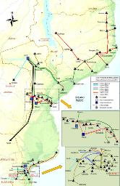






Electricity IV Mozambique project
4 Interconnected Substations – Transmission project
Project Status :
DELIVERY
* Highlights
4 Interconnected Substations
220/110/66/33/22/11 kV
Schneider Electric PACIS HMI
Network Redundant Architecture
Solution built on IEC61850 Protocol
Interface with 3rd parties equipments
162 IEDs in 61850 or Modbus
45 Cubicles
Selectivity study & relay settings
Full Commissioning package
Factory & Site Training
Consultant
Notes:
20

Slide 21

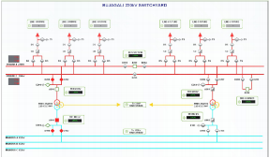
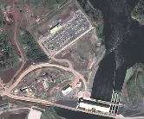



Bujagali project
Substation upgrade – Uganda / Kenya Interconnexion project
Project Status :
ENERGISED
* Highlights
Hydro Generation Power Plant
Upgrade of existing 33/132 kV Substation
33/132/220 kV
Substations Interconnection
Schneider Electric PACIS HMI
Network Redundant Architecture
Solution built on IEC61850 Protocol
Interface with 3rd parties equipments
45 IEDs in 61850
11 Cubicles
Selectivity study & relay settings
Full Commissioning package
Factory & Site Training
Consultant
Notes:
21

Slide 22
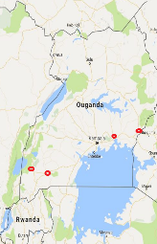
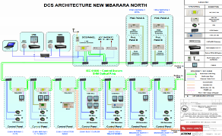
Uganda project
Uganda / Kenya Interconnexion project
Project Status :
DELIVERY
* Highlights
3 New Substations
1 Substation upgrade
220/132 kV
Schneider Electric PACIS HMI
Network Redundant Architecture
Solution built on IEC61850 Protocol
Interface with 3rd parties equipments
155 IEDs in 61850
75 Cubicles
Selectivity study & relay settings
Full Commissioning package
Factory & Site Training
Consultant
Notes:
22

Slide 23

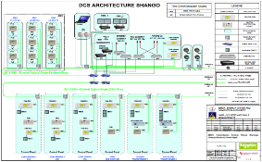

Rwanda Congo Interconnection project
Rwanda / Congo Interconnexion project
Project Status :
DELIVERY
* Highlights
4 Substations in Rwanda
1 Substation in Congo
220/110/30 kV
Schneider Electric PACIS HMI
Network Redundant Architecture
Solution built on IEC61850 Protocol
Interface with 3rd parties equipments
130 IEDs in 61850
110 Cubicles
Selectivity study & relay settings
Full Commissioning package
Factory & Site Training
Consultant
Notes:
23

Slide 24





Rwanda Takaoka project (DSO)
Rwanda / 4 Distribution substations
Project Status :
DELIVERY
* Highlights
4 Substations in Rwanda
110/15 kV
Supply scope:
PACIS System with WEB HMI
TELECOM System
Smart Terminal Block Marshalling Kiosk
Ring Redundant Architecture
Solution built on IEC61850 Protocol
36 IEDs in 61850
17 Cubicles
Selectivity study & relay settings
Full Commissioning package
Factory & Site Training
Notes:
24

Slide 25
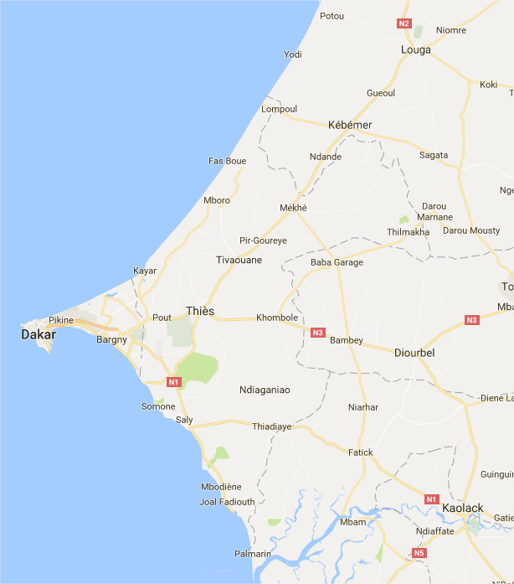
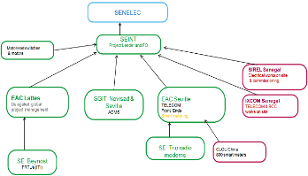
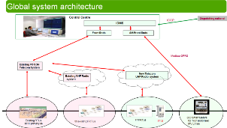



IDMS – SENEGAL
IDMS – Senegal for 30 MV/LV Substations 33 /0,4 kV
Supply scope: DMS, telecom system, RTUs, Smart Meters,
MVS (AIS, closed cells, motor kit), Site activities
Project Status :
DESIGN
- SCADA/DMS system including advanced functions VVO, FLISR, Load forecast, WOM, LV network model, OMS, DTS
- 159 RTUs in S/S
- Front End RTUs (Saitel DP)
- TELECOM system (radio modems and antennas)
- 800 LV Smart meters integrated in IDMS
- 30 motorised switches 30kV & 6 SM6 closed cells
- Site activities
Notes:
25

