Slide 1

Easergy MiCOM P40
Smart Relays as Core Building Blocks for our Smart Digital Substation Story
Araceli Monje, Alain Guilhen
May 2018
Notes:
This is an example of a Title Slide. We need to convey Life Is On in everything we do, so try to lead with compelling images that are vibrant, authentic, and human. The human element should be apparent and within the context of a segment that we touch.
To keep this PowerPoint template file size reduced, we included a small library of image choices in the Slide Master (under View). You can also get them from the SE Asset Library: https://schneiderelectric.telescopeondemand.com

Slide 2
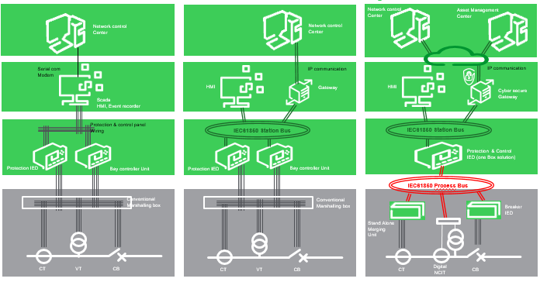
Substation digitization is a journey…
And Easergy MiCOM P40 joins this journey as a core building block!
Conventional wired substation
Digital control Panel
Digital Substation
Enterprise level
Edge
control
Connected
Product
MV switchboard
Connected products
Equipment & sensors
Powered 1st Gen Digital Relays
Powered by IEC61850
Powered by IEC61850 & Sensors
2000
2020
Notes:
2 main evolutions : Station bus in 2015s and Process bus for a complete digital evolution from Connected products & equipents to Enterprise level
We foresee a next coming evolution to Virtualization in coming 10 years

Slide 3

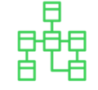

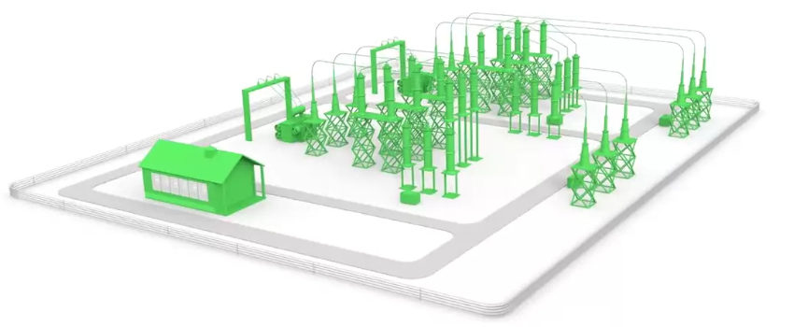

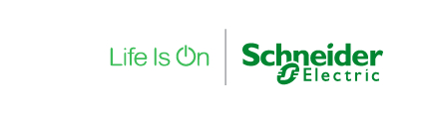
Bringing an IED fully compliant with latest standards…
Condition Monitoring
and Asset performance management:
ISO 55000
Stand alone Merging unit (SAMU)
Non conventional Instrument transformer (NCIT)
IEC 61850-9-2, IEC 61869-13
End to end Cybersecurity
IEC62443, IEC62351
NERC-CIP
IEC 61869 Process bus
Sample values IEC 61850-9-2
CB control IEC 61850-8-1 Goose
Time synchro IEEE 1588
IEC 61850-8-1 Station bus:
Protection and Control System
Time synchronization IEEE1588
Evolving requirements
Breaker IEDs
Smart Terminal blocks IEC 61850
Non mature standards
Notes:
IMPLICATIONS of Market and Technological TRENDS are new regulation and standards

Slide 4
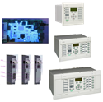
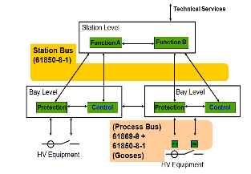
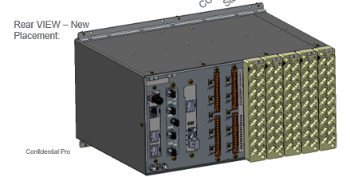
MiCOM P40 Series – Process Bus
Process Bus Board in Easergy MiCOM P40 series
SELL = P540D, P14x, P64x : Q3 2018 and P44x, P746 : Q4 2018
New Process Bus Board in Easergy MiCOM P40 series
  Compliant with latest PB standard IEC61869-9
  Backwards compatibility with previous standard 9-2 LE
  Sampled Values and GOOSE supported in the same Ethernet interface
  Fully compliant with IEC61850 Ed 2
  Ethernet Redundancy provided (PRP)
  Advanced Cybersecurity features (RBAC, port hardening, password management, security logs)
  Fully Compatible with the enhanced IEEE1588/RSTP Station Bus Board
  Full coverage of Transmission Applications (Feeder, Line Diff, Distance, Transformer and Busbar)
Process Bus Architecture principle and Hardware
Keep on improving our products to defend our T&D market
Internal use only

Slide 5


Cost savings in terms of raw materials, cubicle engineering & wiring verification (up to 70% time reduction in these tasks), as the high amount of copper wires are replaced by Ethernet cables.
Improving your people safety as by replacing the analog signals by digital sampled values, dangerous wires are completely removed from the protection cubicle.
Full interoperability achieved in a multivendor environment thanks to full compliance with process bus latest standards IEC61869 & 9-2LE.
Enhanced continuity of service & maintenance thanks to the inherent isolation that process bus provides from primary circuits.
Augmented reliability & availability reached through Ethernet standarized redundancy & Advanced Cybersecurity features.

